Slide 1
MARKETING AND RETAIL ANALYTICS
PGPBABI – SECTION B
Group 7
Biren Indrajit Sampat
Ekta Gupta
Jaya Garg
Rajesh M
Vikram Mangharam

Slide 2
Introduction
The owner of Café Great restaurant wants to setup a Café Chain to increase his revenues. He (owner) has not been able to launch a loyalty program and has approached our group for advise.
We have conducted the below analysis and have listed out suggestions/ recommendations
Exploratory Analysis
Menu Analysis
Price Analysis

Slide 3
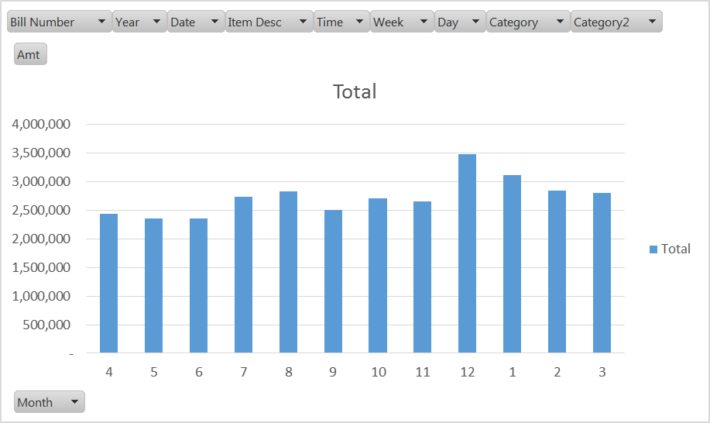
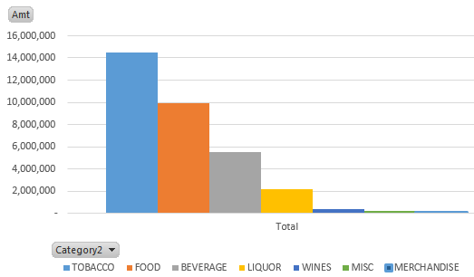
Exploratory Data Analysis
Overall Annual Sales - $32.81M
The café has an Average sales per month - $2.73M. Month-on-month Sales is general flat with a small spike in summer (Jul-Aug) and higher uptake during the holiday season (Dec) ($3.5M) then tapers off.
Category | Total | Share by Cat
TOBACCO | 14,507,076 | 44%
FOOD | 9,952,728 | 30%
BEVERAGE | 5,510,239 | 17%
LIQUOR | 2,156,009 | 7%
WINES | 352,912 | 1%
MISC | 206,858 | 1%
MERCHANDISE | 120,074 | 0%
Grand Total | 32,805,895 | 100%
Categories – The café has significant sales in Tobacco accompanied with Food & Drinks. Categories like Wines, Merchandize and Misc. have insignificant sales.

Slide 4
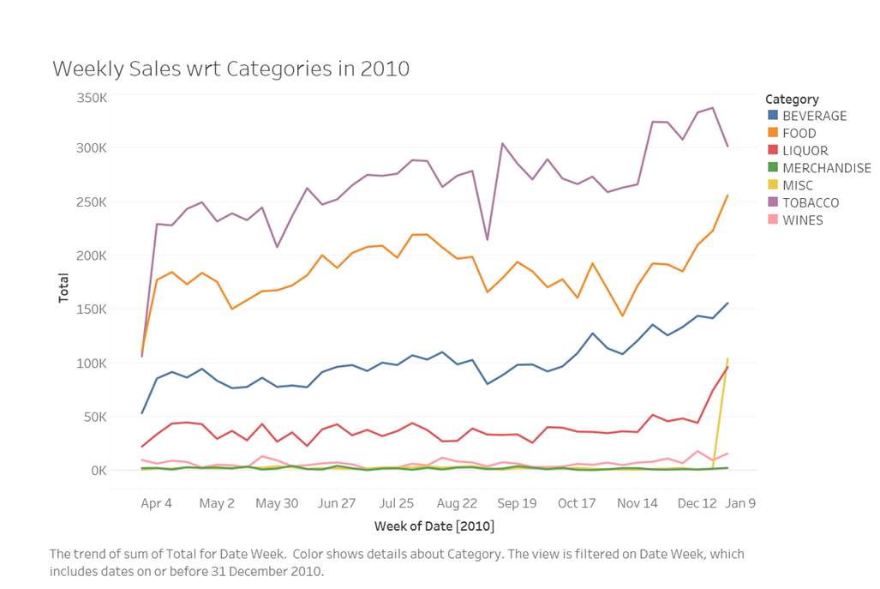
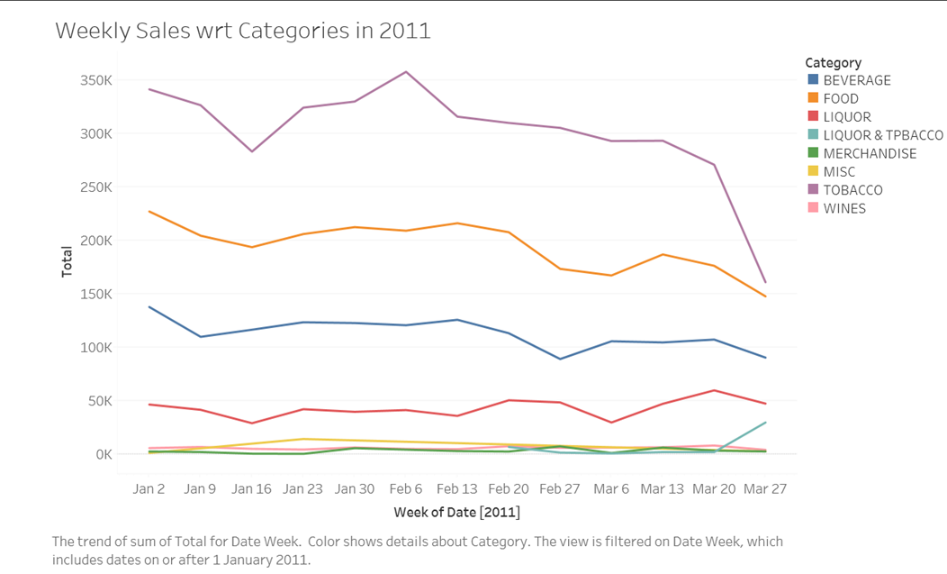
Exploratory Data Analysis

Slide 5
Exploratory Data Analysis

Slide 6
Exploratory Data Analysis
Every day, 7:00 – 9:00 AM seems to be café closed hours.
The highest sales of Café Great usually starts from 7:00 PM onwards till mid-night (01:00 AM). On any given day from Apr 2010 to Mar 2011, the average sales tops at the mentioned time.
The data shows exponential raise in store sales from 11:00 AM of the day till 6:00 PM, as there is increase in the frequency of customers visiting café at this point of time.
The early hours of the day, 02:00 till 09:00 AM has the less sales on any given day for the data collected time interval.

Slide 7
Exploratory Data Analysis
Observations (Categories)
Categories - Wines, Merchandize and Miscellaneous have insignificant sales but are high on inventory.
Wines:
It is observed that wine is mostly sold by glass. However, since the café offers a wide variety of wines, there is a high likelihood many open bottles may remain in stock for a while and go bad. This may also explain the low sale of wine.
Wines accompany Liquor & Beverages may help sales. So ok to carry some stock. Since we recommend keeping a limited range of wines sold by glass.
Merchandize:
Merchandize are little items that may help bring the customer into the store but sales are very low. So carrying selected stock may still help pull customers in and does not fill up shelves with idle stock. The below list covers approx 35% revenue of Merchandize sales
Item Desc | Amt | Qty | % of total Merchandize Sales
GREAT LAKES T-SHIRTS | 13,352 | 37 | 11%
SANDASS | 9,845 | 19 | 8%
FLAVOUR 500 GMS | 6,379 | 7 | 5%
CH COFFEE MUGS | 6,050 | 27 | 5%
CH TINS | 5,842 | 26 | 5%
Sub-total | 41,468

Slide 8
Exploratory Data Analysis
Observations (Categories)
Miscellaneous:
Observed several misclassifications. While item rates seem correct, the billing seems to be entered manually under “Miscellaneous”. This is mainly due to the large number of items under each category.
The incidents of incorrect category was mainly on 31st Dec when traffic was high and servers were punching away bills in a frenzy.
Example of misclassification as Miscellaneous - e.g.
Item Desc | Amt | Qty | Classified as | Should be under
RED BULL SHEESHA | 61,182 | 103 | Misc | Tobacco
PEACH BULL | 2,413 | 13 | Misc | Beverage

Slide 9
Exploratory Data Analysis
Observations (TimeLine)
Behavior during the year:
Popularity of the café seems to have caught on and sales have picked up Q-o-Q.
Merchandise sales are seasonal picking up during Q4
Wine sales follow trend of holidays
Behavior during different months:
Tobacco-Liquor combo started in Feb and has shows a upward trend and has started evening out sales through the week. This is a positive trend to offer combos on weekdays.
Customers opting for Combo seem to stay longer and order more there by promoting sales of other items. Overall this has had a positive impact as the upward trend continues even after the holidays

Slide 10
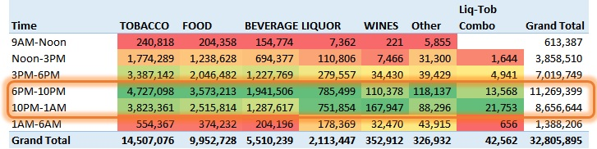
Exploratory Data Analysis
Observations (TimeLine)
Category | Avg. Weekend | Avg. Weekday | Wk-end vs Wk-day
TOBACCO | 2,247,054 | 2,002,594 | 12%
FOOD | 1,681,581 | 1,317,913 | 28%
BEVERAGE | 921,981 | 733,255 | 26%
LIQUOR | 372,529 | 273,678 | 36%
WINES | 55,983 | 48,189 | 16%
MERCHANDISE | 18,849 | 16,475 | 14%
LIQUOR & TOBACCO | 2,403 | 7,551 | -68%
Behavior during the Week:
Overall Average week-end sales is 20% higher than week-day sales for the year
Food & Liquor lead the week-end uptake over week-days
Combo offering is more popular on week-days.
Behavior during different times of the day:

Slide 11
Menu Analysis
No Combo meals in the menu currently.
Apriori algorithm used in R to come up with association Rules for suggestion of combos that can enhance the sales.
Attached is the code followed by analysis.

Slide 12
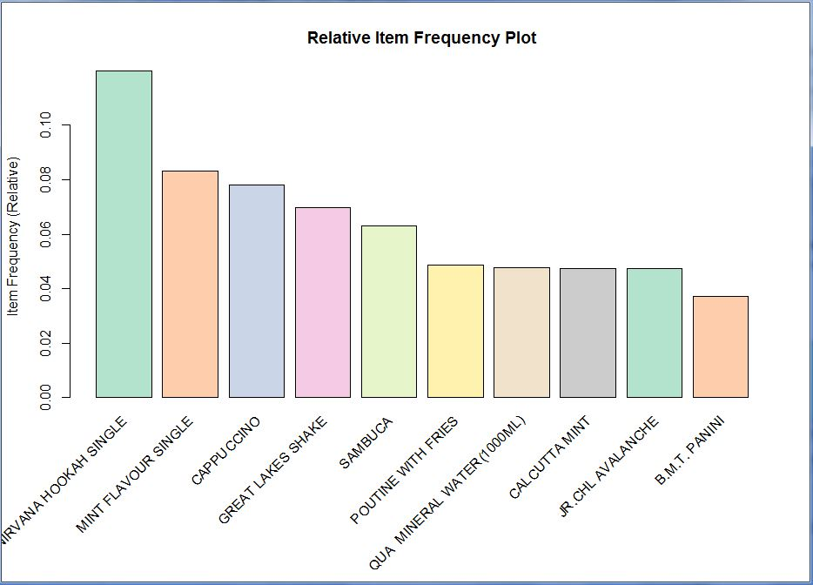
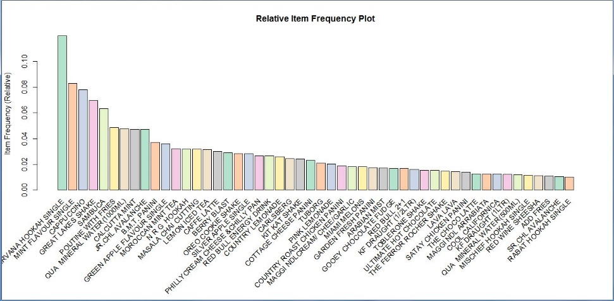
Menu Analysis
The Item Frequency Histogram
The relative frequency plot accounts for the fact that “Nirvana Hookah Single” is the most sought after item of the café followed by “Mint Flavor Single”, “Cappuccino”, “Great Lakes Shake” and “Sambuca”. To boost the sales of low selling items like “Rabat Hookah Single", "Maggi NDL Arrabiata”, “Add Fries” can be clubbed with these high selling items and enhance the sales.

Slide 13
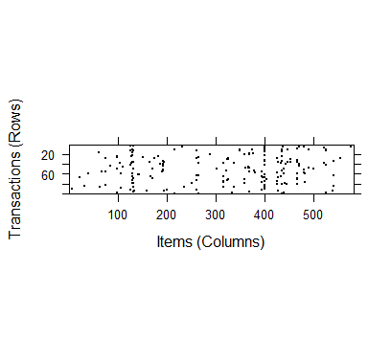
Menu Analysis
The Sparse Matrix
When we visualize the items for a random selection of 100 transactions, A few columns seem fairly heavily populated, indicating some very popular items at the store. But overall, the distribution of dots seems fairly random.

Slide 14
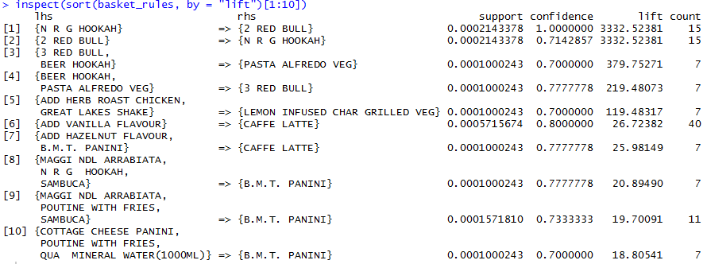
Menu Analysis
Association Rules – I
The first two rules, with a lift of about 3332.5, implies that people who buy N R G HOOKAH are nearly 3333 times more likely to buy 2 RED BULL than the typical customer and vice versa.
The 3rd and 4th rule, implies that people who buy 3 RED BULL and BEER HOOKAH are 380 times more likely to buy PASTA ALFREDO VEG and vice versa.
Similarly, there is 120 times more likely that LEMON INFUSED CHAR GRILLED VEG is ordered along with ADD HERB ROAST CHICKEN and GREAT LAKES SHAKE.

Slide 15
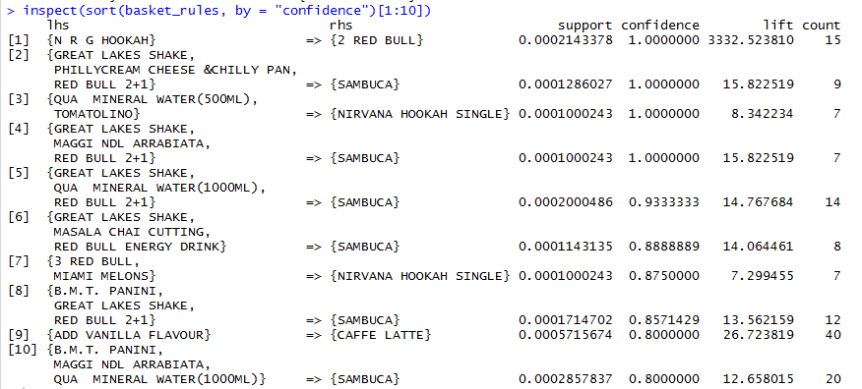
Menu Analysis
Association Rules - II
But if we sort the rules as per confidence or the condition probability of the occurrence, we see that probability of ordering SAMBUCA with different top 10 combinations is the highest.

Slide 16
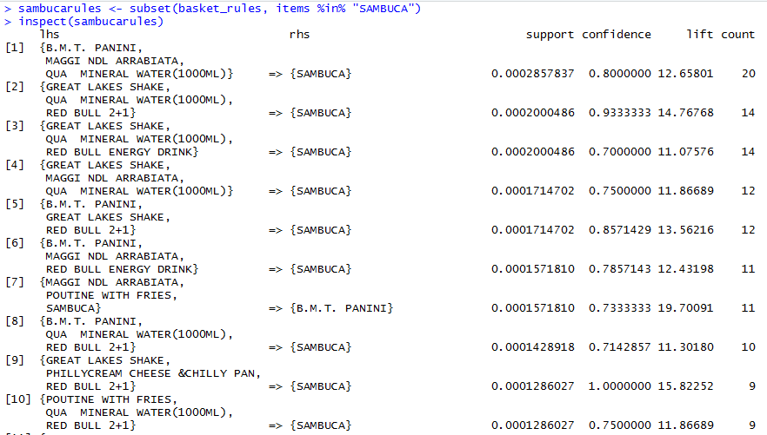
Menu Analysis
Association Rules - III
So, by inspecting the transactions on SAMBUCA, we can introduce a combo of :
B.M.T. PANINI, MAGGI NDL ARRABIATA, QUA MINERAL WATER (1000ML) and SAMBUCA.
GREAT LAKES SHAKE, QUA MINERAL WATER (1000ML), RED BULL ENERGY DRINK and SAMBUCA.

Slide 17
Menu Analysis
Summary
By visualizing these rules and plots, we propose the below combos:
Combos Proposed:
N R G HOOKAH and 2 RED BULL
3 RED BULL, BEER HOOKAH and PASTA ALFREDO VEG
LEMON INFUSED CHAR GRILLED VEG, ADD HERB ROAST CHICKEN and GREAT LAKES SHAKE
B.M.T. PANINI, MAGGI NDL ARRABIATA, QUA MINERAL WATER (1000ML) and SAMBUCA.
GREAT LAKES SHAKE, QUA MINERAL WATER (1000ML), RED BULL ENERGY DRINK and SAMBUCA.

Slide 18
Price Analysis
Overall there were 249 price changes across 171 SKUs
Analysable price changes however were 140 over 98 SKUs

Slide 19
Price Analysis
Customized or One Off Price Changes seem to be due to the following factors
Existence of size as a variable which has not been captured in the data
Possible Mistakes of new untrained employee
Experiments conducted multiple times in a single day
Customised Pricing for known / regular customers
Sample attached below for 2 SKUs – 1+1 Wine Bottle & 1+1 Wine Glass

Slide 20
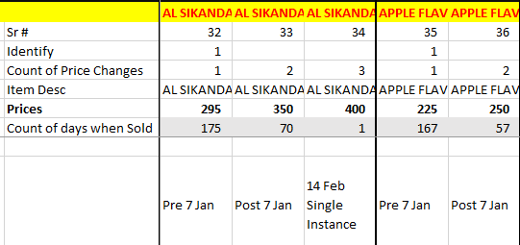
Price Analysis
Festive Price Changes which were done only on specific days like 25 Dec, 31 Dec or 14 Feb
Used as a marketing strategy only for specific days, to boost revenue by increasing prices
We have ignored these price changes also as it was for only a single festive occasion
Sample attached for 1 SKU - AL SIKANDARI HOOKAH SINGLE
Other SKUs include
ADD ON S
AIOLI SALAD BOWL
ASIAN WOK TOSSED SALAD
BUDWEISER
CEASAR SALAD BOWL
CHICKEN BURGER
COTTAGE CHEESE PANINI
COUNTRY LEMONADE
COUNTRY ROAST CHICKEN PANINI
FRENCH VINAIGRETTE SALAD BOWL
FRUIT FROM THE TROPICS
HERBED CHICKEN PIE
HERBED GARDEN PIE
LEBANESE CHICKEN WRAP
LEMON ICED TEA
MOROCCAN SOY KEBABS
O M G GRILLED BURGER
OREO COOKIE SHAKE
PASTA ALFREDO NONVEG
PASTA ALFREDO VEG
PASTA ARABIATA NONVEG
PASTA ARABIATA VEG
PCJ PATTY BURGER
SR.CHL AVALANCHE
TENNESSEE CHICKEN WINGS
TOBLERONE SHAKE
VEG. CLUB WRAP
VERTIGO

Slide 21
Price Analysis
Analyzable Price Changes were 140 instances over 98 SKUs
There were more SKUs where Price increases were beneficial with 44 out of 75 SKUs showing an increase in Sales
Items where Prices were dropped, 12 out of 18 SKUs saw a increase in Sales volume
In addition to these there were a few SKUs which saw a drop & then a rise in Price
Many of the SKUs where the Price Change was not positive missed it due to minor drop in sales
Suggest continuing with the Price Changes where the Revenue impact is positive despite drop in quantity
5 SKUs had seen an initial drop in prices
& then an increase in prices
Hence, since the final impact was for price increase
we have included those 5 SKUs in the Price Increase Segment
for our Four Quadrant Analysis in the next slide

Slide 22
Price Analysis
Sales Decrease with Price Increase
34 SKUs
Average Sales Decrease -37%
Average Price Increase 24%
Sales Increase with Price Increase
46 SKUs
Average Sales Increase 282%
Average Price Increase 20%
Price
Decrease Increase
Sales Decrease with Price Decrease
6 SKUs
Average Sales Decrease -30%
Average Price Decrease -18%
Sales Increase with Price Decrease
12 SKUs
Average Sales Increase 113%
Average Price Decrease -13%
Decrease Sales Quantity Increase

